Slide 1

SUMMER BOOTCAMP PROJECT 2024 aiml food hubs
YUKTI ARORA

Slide 2
INDEX
COVER PAGE
INDEX
LIST OF TABLES
LIST OF FIGURES
PROBLEM STATEMENT
DATA DICTIONARY
BASIC EDA
PROBLEMS

Slide 3
LIST OF TABLES:
FIRST FIVE ROWS OF DATASET
LAST FIVE ROWS OF DATASET
STATISTICAL SUMMARY OF DATASET
STATISTICAL SUMMERY PER COLUMN
DIFFERENT VALUE REPRESETATION
AVERAGE RATING PER CUISINE

Slide 4
LIST OF FIGURES
DATA DESCRIPTION
NULL VALUE COUNT
BOXPLOT OF FEATURES
BOXPLOT FOR COST OF ORDERS TOTAL NO. OF ORDERS IN DATASET
AVERAGE RATING BY CUSTOMERS
DISTRIBUTION OF ORDERS FOR DIFFERENT DAYS
AVERAGE PREP TIME PER RESTAURANT
CORRELATION HEATMAP FOR COST OF ORDER AND RATING
DEMAND FOR CUISINES ON WEEKDAYS AND WEEKENDS
AVERAGE RATING BY CUISINE TYPE
CORREALTION HEATMAP FOR FROOD PREP TIME AND DELIVERY TIME
CORREALTION HEATMAP FOR DELIVERY TIME AND CUSTOMER RATINGS

Slide 5
PROBLEM STATEMENT
The food aggregator company has stored the data of the different orders made by the registered customers in their online portal. They want to analyze the data to get a fair idea about the demand of different restaurants which will help them in enhancing their customer experience. Suppose you are hired as a Data Scientist in this company and the Data Science team has shared some of the key questions that need to be answered. Perform the data analysis to find answers to these questions that will help the company to improve the business.

Slide 6
DATA DESCRIPTION:
The data contains the different data related to a food order. The detailed data dictionary is given below.
Data Dictionary
order_id: Unique ID of the order
customer_id: ID of the customer who ordered the food
restaurant_name: Name of the restaurant
cuisine_type: Cuisine ordered by the customer
cost: Cost of the order
day_of_the_week: Indicates whether the order is placed on a weekday or weekend (The weekday is from Monday to Friday and the weekend is Saturday and Sunday)
rating: Rating given by the customer out of 5
food_preparation_time: Time (in minutes) taken by the restaurant to prepare the food. This is calculated by taking the difference between the timestamps of the restaurant's order confirmation and the delivery person's pick-up confirmation.
delivery_time: Time (in minutes) taken by the delivery person to deliver the food package. This is calculated by taking the difference between the timestamps of the delivery person's pick-up confirmation and drop-off information

Slide 7
ANALYSIS:
ORDER ANALYSIS
CUSTOMER BEHAVIOUR
RESTAURANT PERFORMANCE
DEMAND PATTERNS
OPERATIONAL EFFIECIENCY
CUSTOMER INSIGHTS

Slide 8
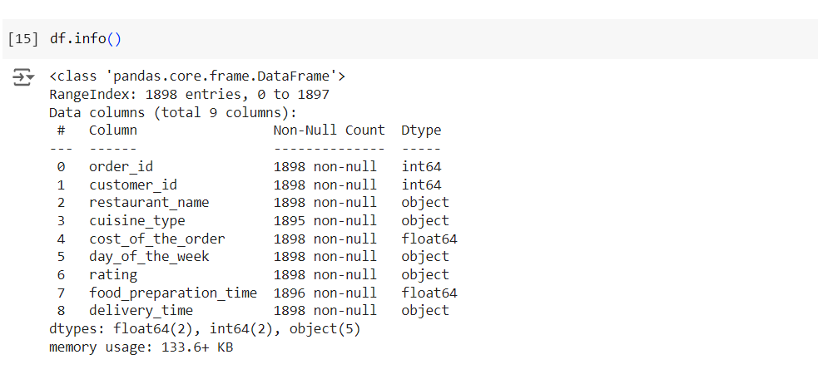
Dataset info:

Slide 9
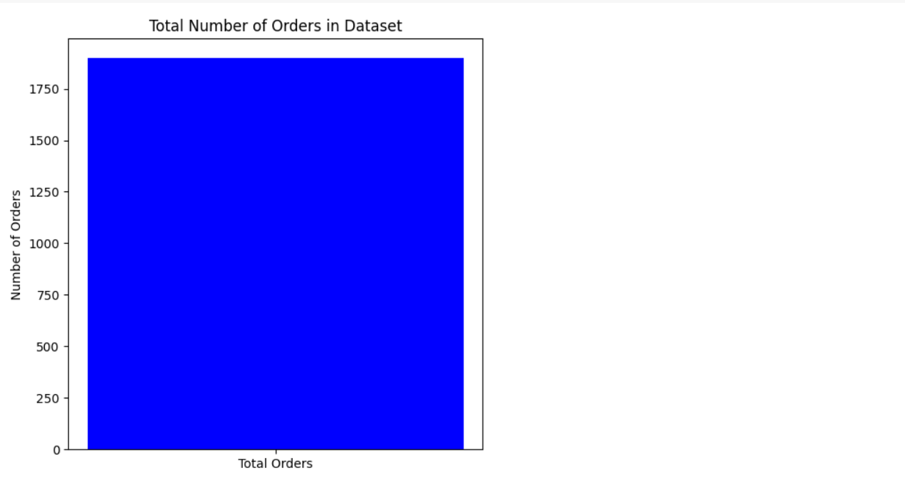
Order analysis:

Slide 10
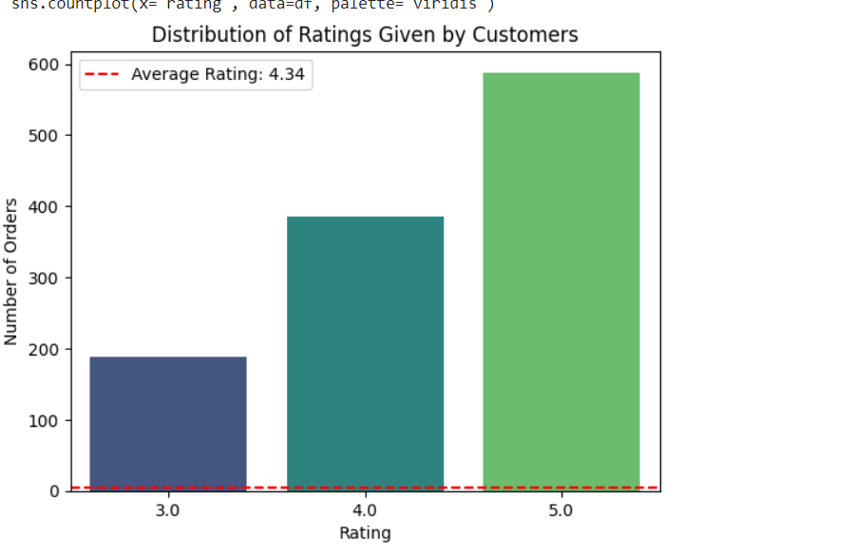
Customer ratings:

Slide 11
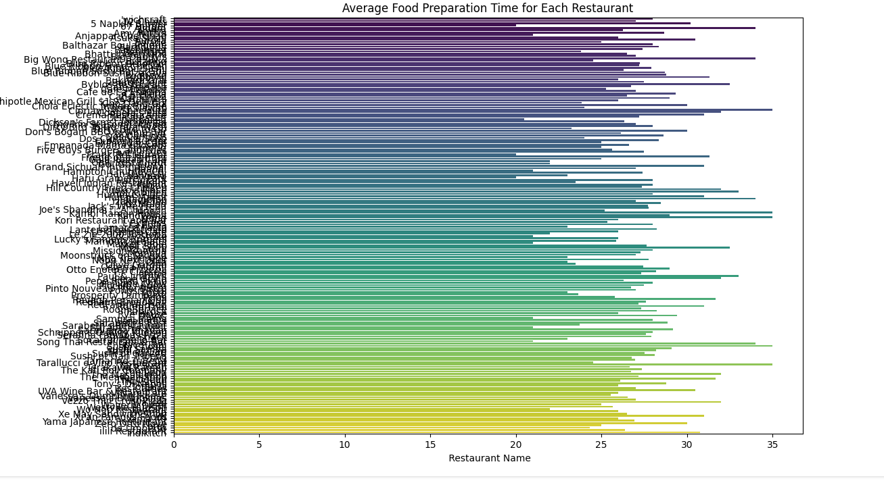
Restaurant analysis:

Slide 12
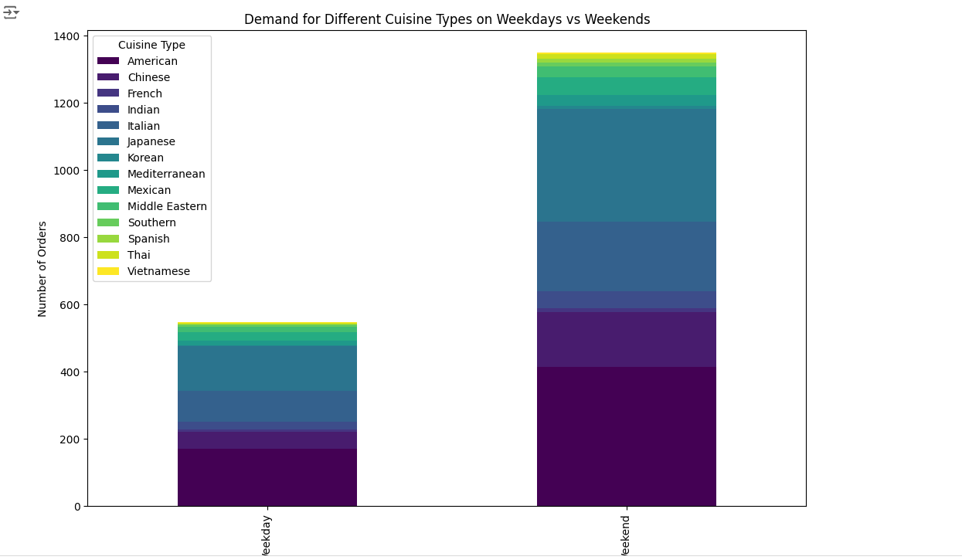
Demand patterns:

Slide 13
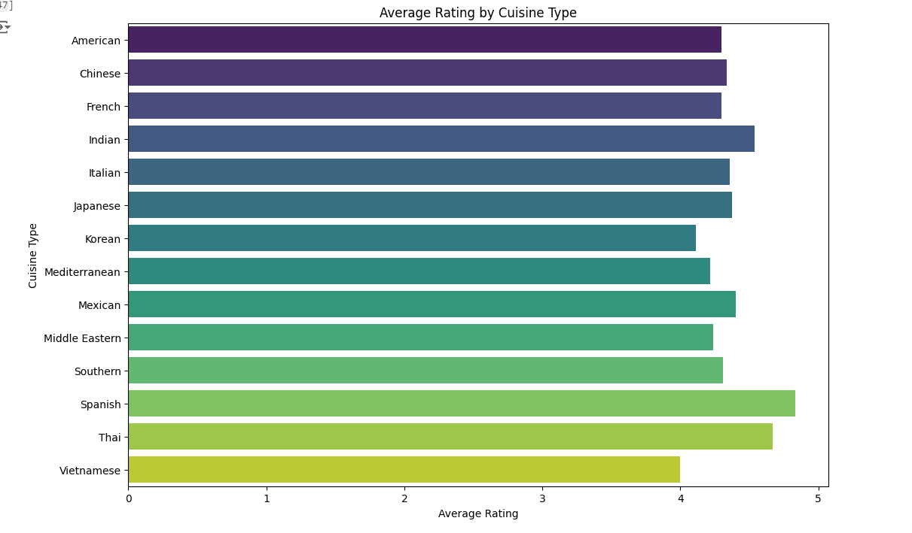
Operational efficiency:

Slide 14
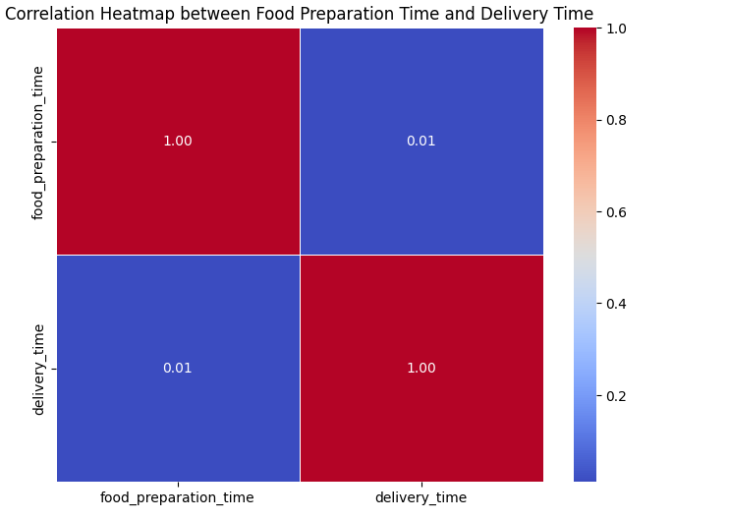
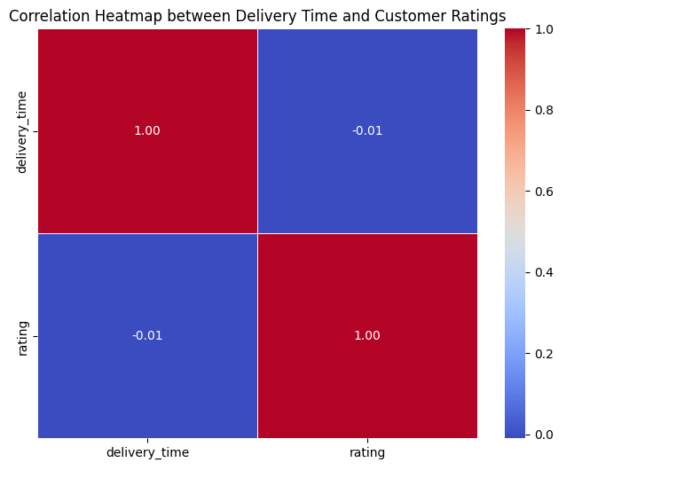
Correlation heatmaps:

Slide 15
THANKYOU

